Slide 1
Chapter 26 Current and Resistance
Key contents
Electric current
Current density and drift velocity

Slide 2
Electric Current
An electric current is a stream of moving charges.
However, not all moving charges constitute an electric current.
To have that, here must be a net flow of charge through a surface.
Consider a flow of water through a garden hose.
Examples of electric currents?

Slide 3
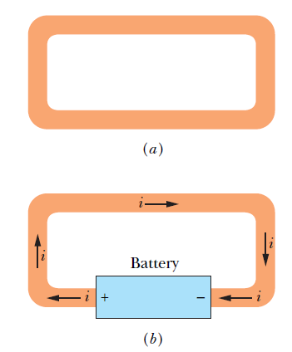
Electric Current: example
The free electrons (conduction electrons) in an isolated length of copper wire are in random motion at speeds of the order of 10⁶ m/s. If you pass a hypothetical plane through such a wire, conduction electrons pass through it in both directions at the rate of many billions per second—but there is no net transport of charge and thus no current through the wire.

Slide 4
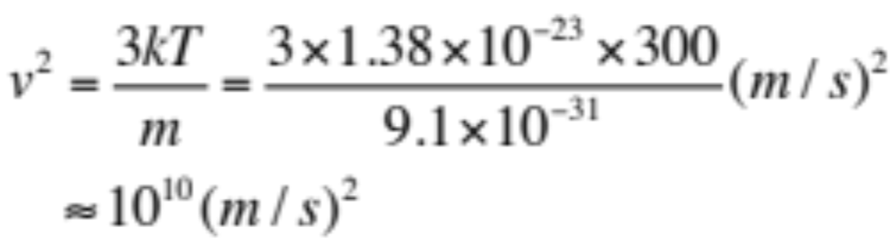
Electric Current: example
However, if you connect the ends of the wire to a battery, you slightly bias the flow in one direction, with the result that there now is a net transport of charge and thus an electric current through the wire.

Slide 5

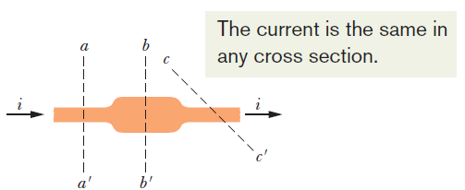

26.2: Electric Current:
The figure shows a section of a conductor, part of a conducting loop in which current has been established. If charge dq passes through a hypothetical plane (such as aa’) in time dt, then the current i through that plane is defined as:
The charge that passes through the plane in a time interval extending from 0 to t is:
Under steady-state conditions, the current is the same for planes aa’, bb’, and cc’ and for all planes that pass completely through the conductor, no matter what their location or orientation.
The SI unit for current is the coulomb per second, or the ampere (A):

Slide 6
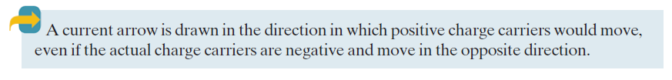
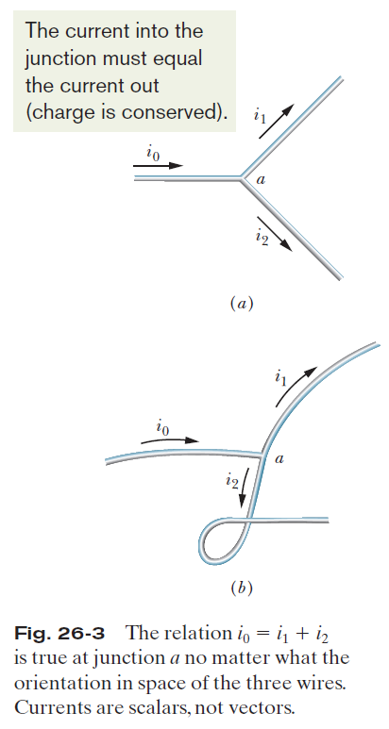
26.2: Electric Current, Conservation of Charge, and Direction of Current:

Slide 7

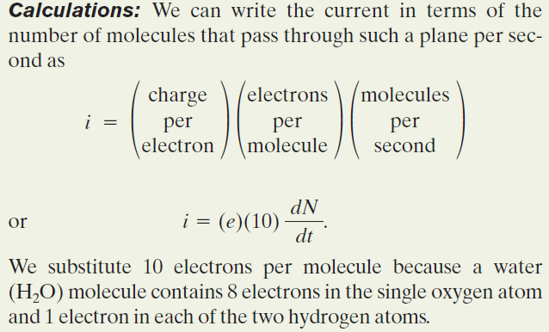
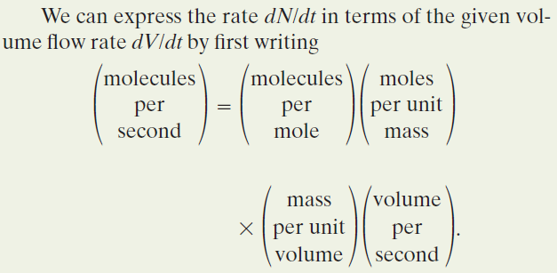
Example:

Slide 8
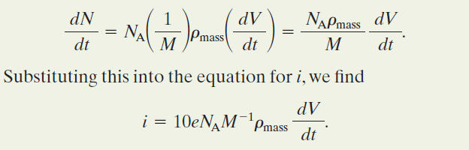
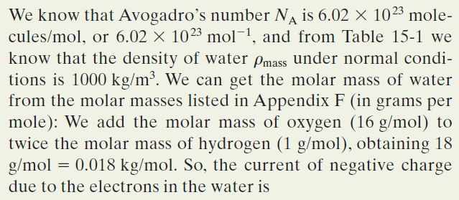
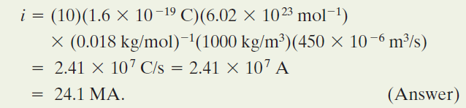
Example:

Slide 9
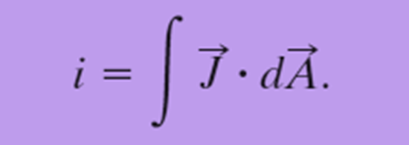
Current Density
The magnitude of current density, J, is equal to the current per unit area through any element of cross section. It has the same direction as the current. This is a local property.
If the current is uniform across the surface and parallel to dA, then J is also uniform and parallel to dA, and then

Slide 10
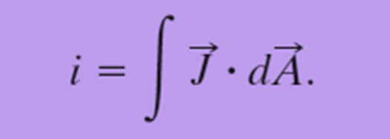
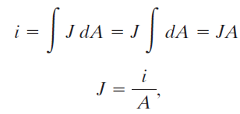
Current Density
Here, A is the total area of the surface.
The SI unit for current density is the ampere per square meter (A/m²).

Slide 11
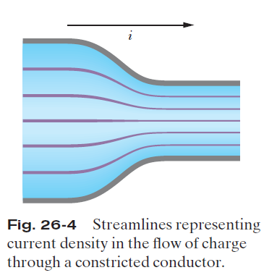
26.3: Current Density:
Figure 26-4 shows how current density can be represented with a similar set of lines, which we can call streamlines.
The current, which is toward the right, makes a transition from the wider conductor at the left to the narrower conductor at the right. Since charge is conserved during the transition, the amount of charge and thus the amount of current cannot change.
However, the current density changes—it is greater in the narrower conductor.

Slide 12
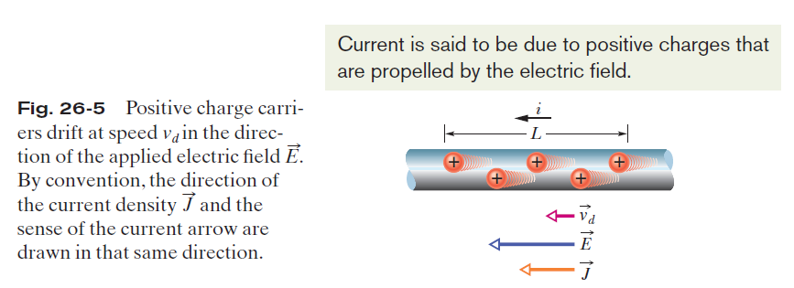
26.3: Current Density, Drift Speed:
What really happens with an electric current flowing in a conducting wire?
!!!

Slide 13


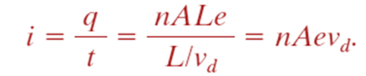
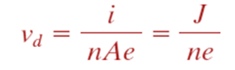
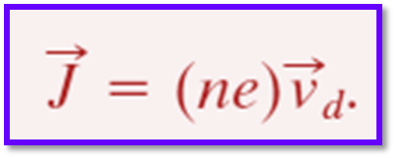
26.3: Current Density, Drift Speed:
When a conductor has a current passing through it, the electrons move randomly, but they tend to drift with a drift speed v_{d} in the direction opposite that of the applied electric field that causes the current. The drift speed is tiny compared with the speeds in the random motion.
In the figure, the equivalent drift of positive charge carriers is in the direction of the applied electric field, E. If we assume that these charge carriers all move with the same drift speed v_{d} and that the current density J is uniform across the wire’s cross-sectional area A, then the number of charge carriers in a length L of the wire is nAL. Here n is the number of carriers per unit volume.
The total charge of the carriers in the length L, each with charge e, is then
The total charge moves through any cross section of the wire in the time interval
is the current

Slide 14
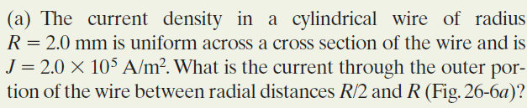
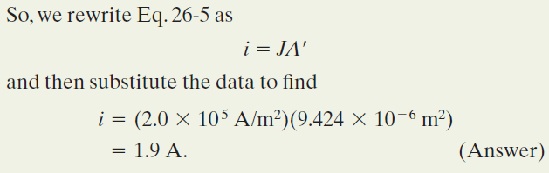
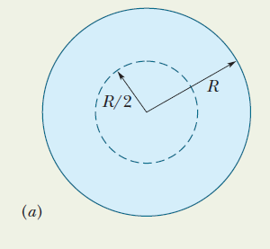
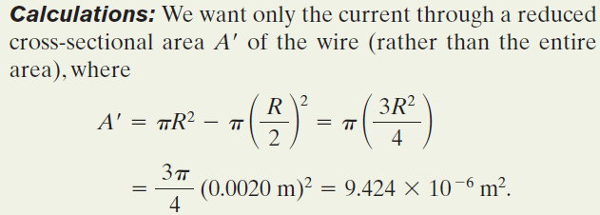
Example, Current Density, Uniform and Nonuniform:

Slide 15
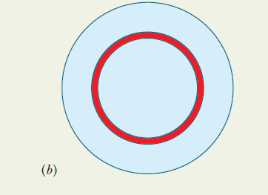
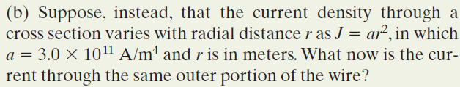
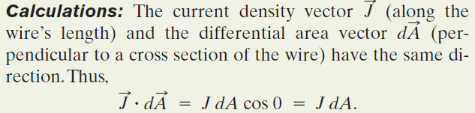
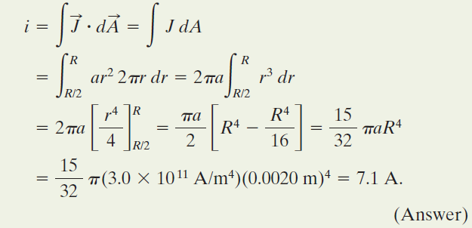
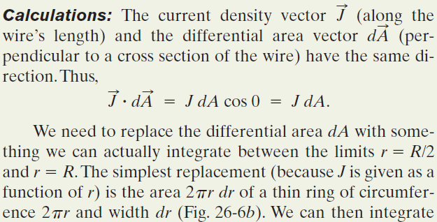
Example, Current Density, Uniform and Nonuniform, cont.:

Slide 16
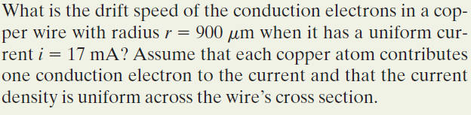
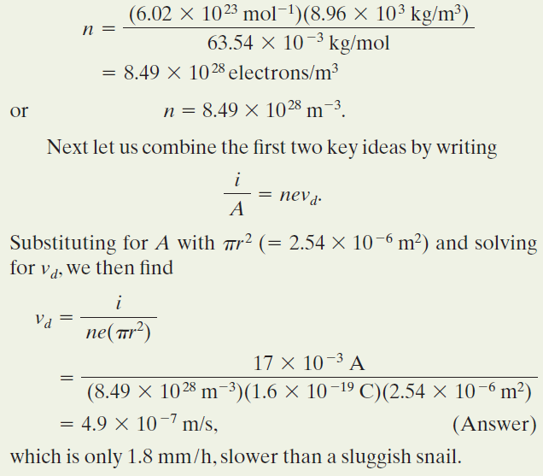
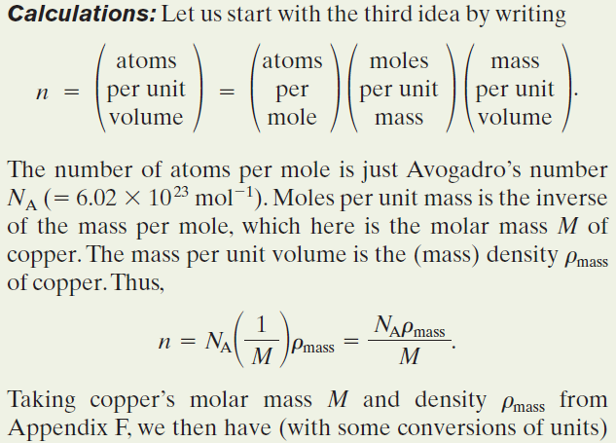

Example: In a current, the conduction electrons move very slowly.

Slide 17


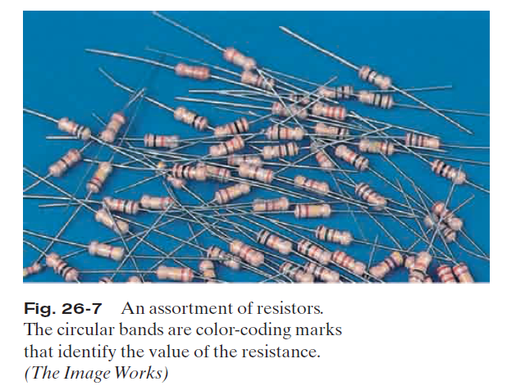
26.4: Resistance and Resistivity:
We determine the resistance between any two points of a conductor by applying a potential difference V between those points and measuring the current i that results. The resistance R is then
The SI unit for resistance that follows from Eq. 26-8 is the volt per ampere. This has a special name, the ohm (symbol Ω):
In a circuit diagram, we represent a resistor and a resistance with the symbol .

Slide 18
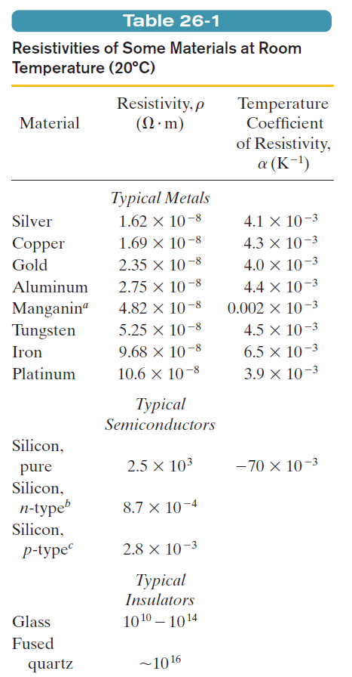

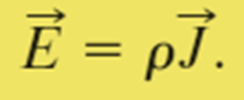

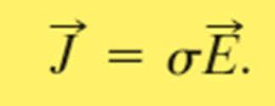
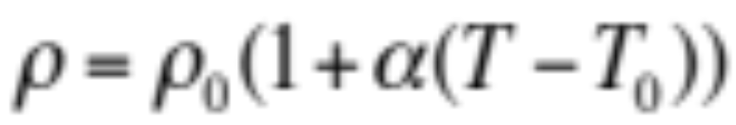
26.4: Resistance and Resistivity:
The resistivity, ρ, of a resistor is defined as:
This is a local property.
The SI unit for ρ is Ω m.
The conductivity σ of a material is the reciprocal of its resistivity:

Slide 19
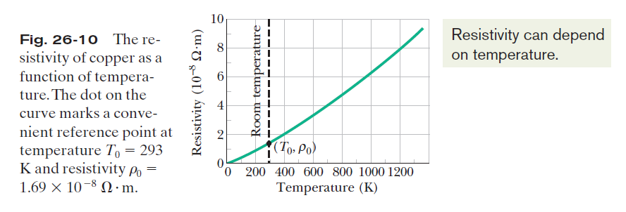
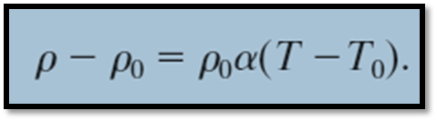
26.4: Resistance and Resistivity, Variation with Temperature:
The relation between temperature and resistivity for copper—and for metals in general—is fairly linear over a rather broad temperature range. For such linear relations we can write an empirical approximation that is good enough for most engineering purposes:

Slide 20
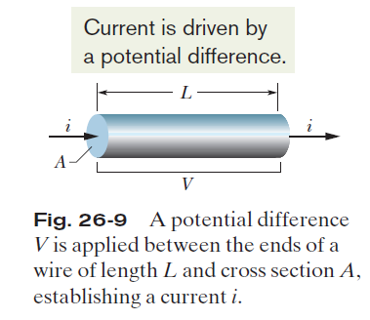



26.4: Resistance and Resistivity, Calculating Resistance from Resistivity:

Slide 21
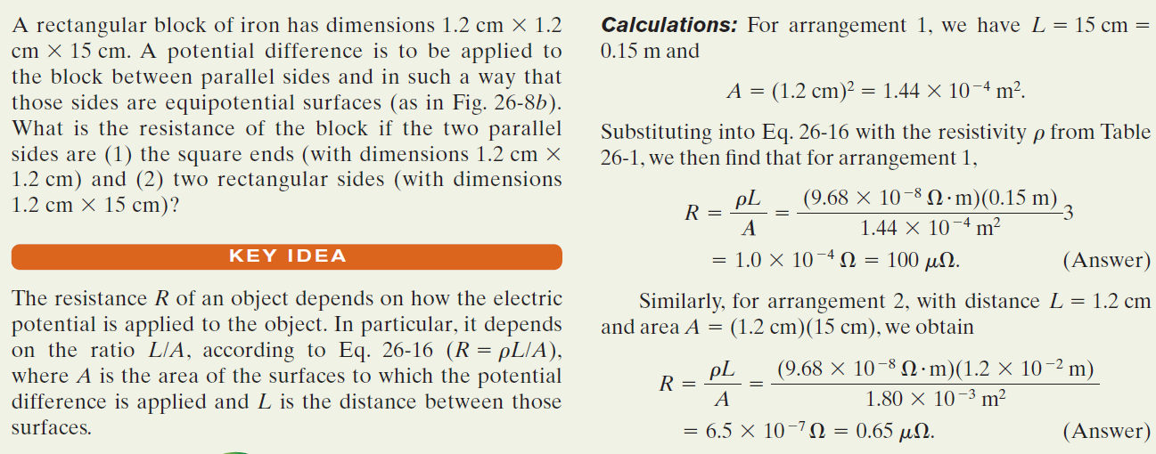
Example, A material has resistivity, a block of the material has a resistance.:

Slide 22

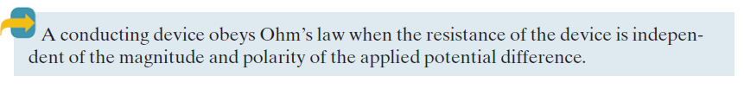
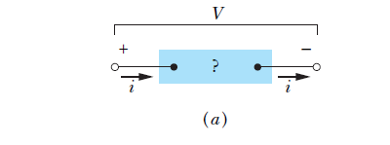
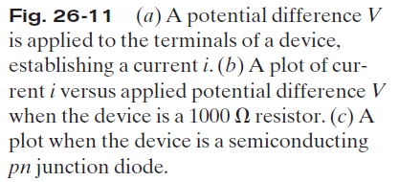
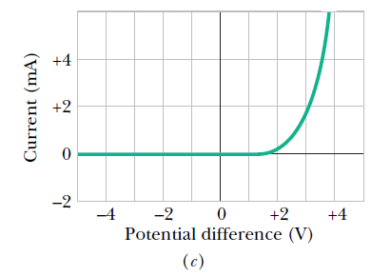
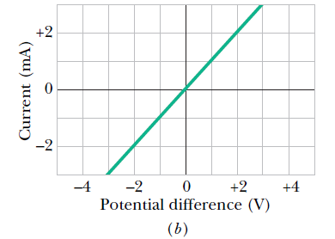
26.5: Ohm’s Law:

Slide 23
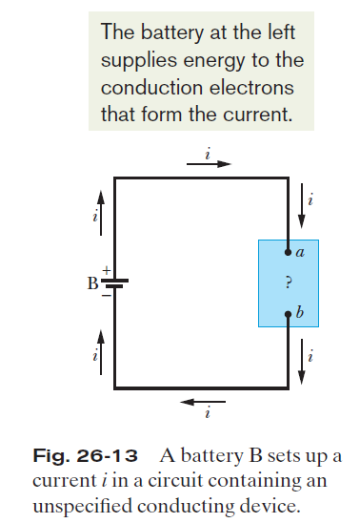





26.7: Power in Electric Circuits:
Charge dq moves through a decrease in potential of
magnitude V, and thus its electric potential energy decreases in magnitude by the amount
The power P associated with that transfer is the rate of transfer dU/dt, given by
The unit of power is the volt-ampere (V A).

Slide 24
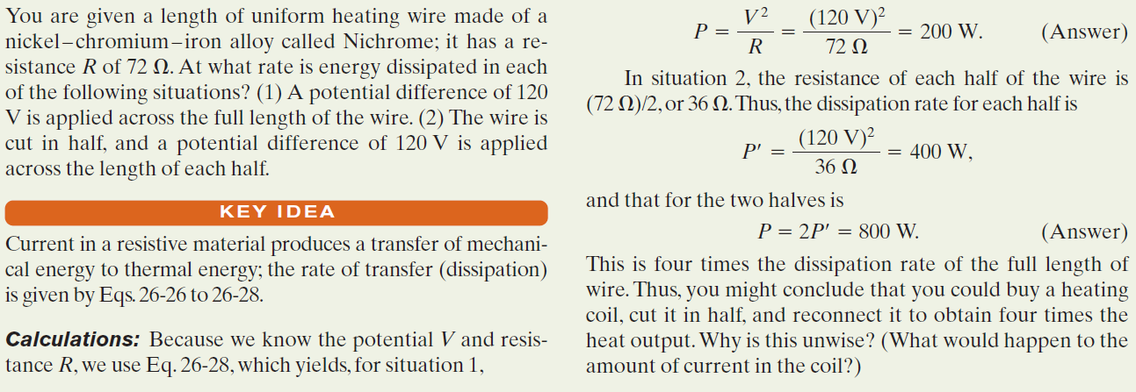
Example, Rate of Energy Dissipation in a Wire Carrying Current:

Slide 25
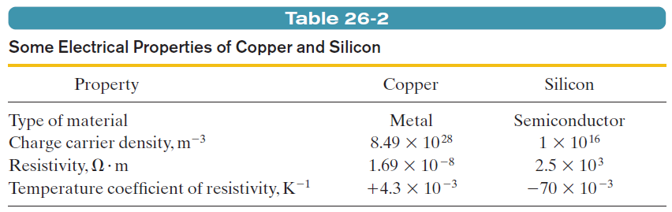

26.8: Semiconductors:
Pure silicon has a high resistivity and it is effectively an insulator. However, its resistivity can be greatly reduced in a controlled way by adding minute amounts of specific “impurity” atoms in a process called doping.
A semiconductor is like an insulator except that the energy required to free some electrons is not quite so great. The process of doping can supply electrons or positive charge carriers that are very loosely held within the material and thus are easy to get moving. Also, by controlling the doping of a semiconductor, one can control the density of charge carriers that are responsible for a current.
The resistivity in a conductor is given by:
In a semiconductor, n is small but increases very rapidly with temperature as the increased thermal agitation makes more charge carriers available. This causes a decrease of resistivity with increasing temperature. The same increase in collision rate that is noted for metals also occurs for semiconductors, but its effect is swamped by the rapid increase in the number of charge carriers.

Slide 26
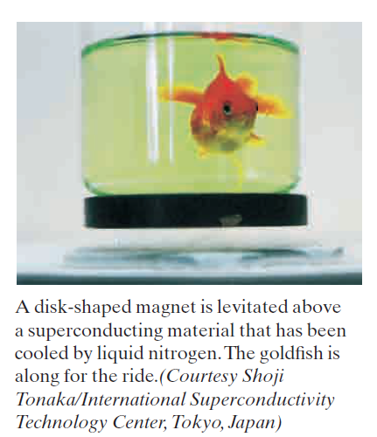
26.9: Superconductors:
In 1911, Dutch physicist Kamerlingh Onnes discovered that the resistivity of mercury absolutely disappears at temperatures below about 4 K .This phenomenon is called superconductivity, and it means that charge can flow through a superconducting conductor without losing its energy to thermal energy.
One explanation for superconductivity is that the electrons that make up the current move in coordinated pairs. One of the electrons in a pair may electrically distort the molecular structure of the superconducting material as it moves through, creating nearby a short-lived concentration of positive charge. The other electron in the pair may then be attracted toward this positive charge. Such coordination between electrons would prevent them from colliding with the molecules of the material and thus would eliminate electrical resistance. New theories appear to be needed for the newer, higher temperature superconductors.

Slide 27
Homework:
Problems 10, 22, 32, 35, 50

